Slide 1

Project Presentation What’s is driving Chinese News? – A Shiny App
Advanced R for Econometricians, Winter 2019 Alexander Gerber and Martin C. Arnold Chair of Econometrics, University of Duisburg-Essen
Nils Paffen (Uni DUE), Eyayaw Teka Beze (Uni DUE), David Schulze (RUB)
Notes:
Welcome to our project presentation: What‘s driving Chinese News? – A Shiny App
This project is part of the course Advanced R for Econometricians.

Slide 2
Structure
Introduction
Shiny App
Webscraping, Captchas, Plots
Automated Scraping, Data Wrangling, Analysis
Conclusion
Notes:
I will give you a short introduction to the topic and the general app functionality. Nils will then talk about his original webscraping algorithm, solving captchas and calculating plots. Eyayaw will continue with a review of his automated scraping function as well as some remarks on data wrangling and analysis.

Slide 3
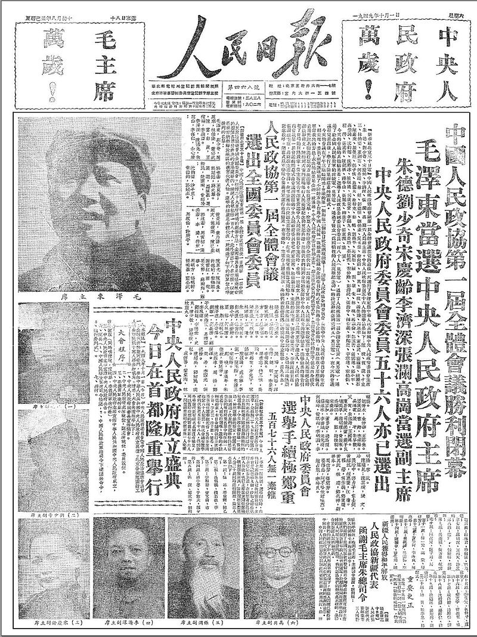
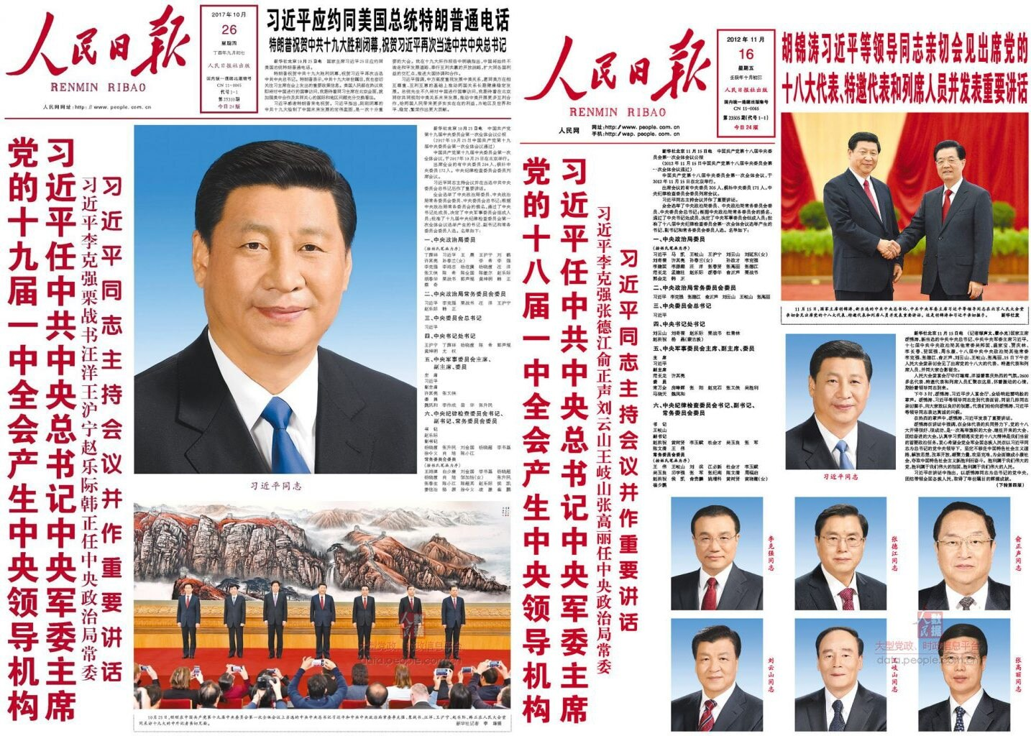
1. Introduction
Image Credit: By People’s Daily - http://news.sohu.com/upload/rmrb49-08/1949.html, Public Domain, https://commons.wikimedia.org/w/index.php?curid=12122624 and People’s Daily http://paper.people.com.cn
Notes:
It is common place to notice that politics matter a lot for economics. This is even more true when looking at economic systems like China‘s where the state reserves an ultimate right and responsibility to control the economy. China has become an indisputable cornerstone of world economic development and an indespensable trading partner for Germany. But information on the way the Chinese government works is not easy to come by. One reason is that developments in Chinese politics will not be openly discussed as in Germany or the US. Researchers instead look at official party documents for insights.
One of the most important of these is arguably the People‘s Daily newspaper. Seen here on the left in 1948 reporting the founding of the PRC by Mao Zedong and on the right the election of Xi Jinping. It can easily be called the most important tool of communication between the Chinese Communist Party, the government it controls and the people that it rules. It is published everyday all over China and also online in the same edition. Even if you read Chinese quickly, keeping up with this daily flood of news and interpreting trends therein is a challenge. We propose therefore an app that provides some tools for evaluating this content quickly through updated text-analysis in a Shiny app that can be used without knowledge of a programming language.

Slide 4
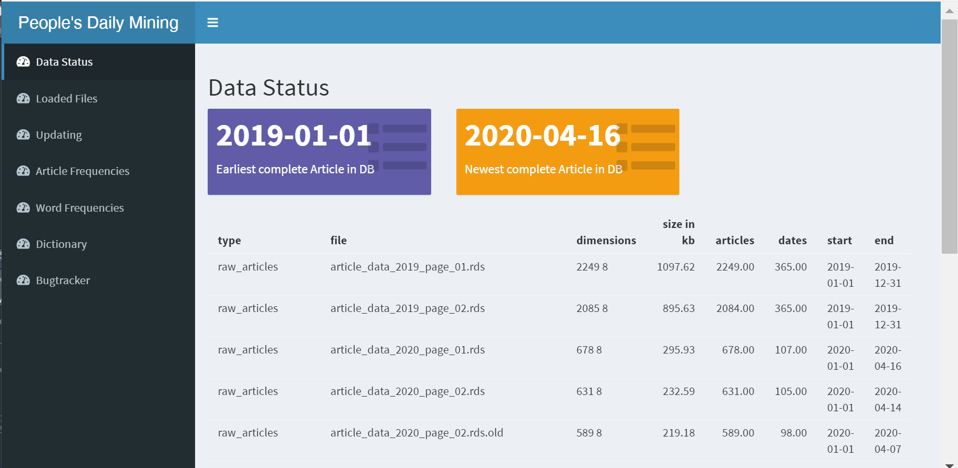
2. Shiny App, Translation
Notes:
When you open the app, the first information that is displayed, shows you the datasets that are already present in the apps folders. This data and it‘s updating is the foundation of the apps functions, because it represents every article published on the first or second page of the People‘s Daily newspaper for the whole of 2019 and 2020 up to the last available day. The first page is arguably the most important page, but the second page can be interesting for comparison.
This screen then shows info that can be used to check roughly if the datasets are ok, what dates they cover and if they are complete. On the left, you can see the menu of other functions included in the app so far: You can check just the names of the loaded files, you can execute an update that will scrape, process and translate new articles and add them to the database, and you can run frequency plots of the number of articles, and certain words per day. Also, in the word frequency tab, you can compare this with an economic index. The dictionary tab allows you to consult the dictionary that is generated by the app, to see which Chinese words an English translation corresponds to. And finally view a list of known bugs.

Slide 5
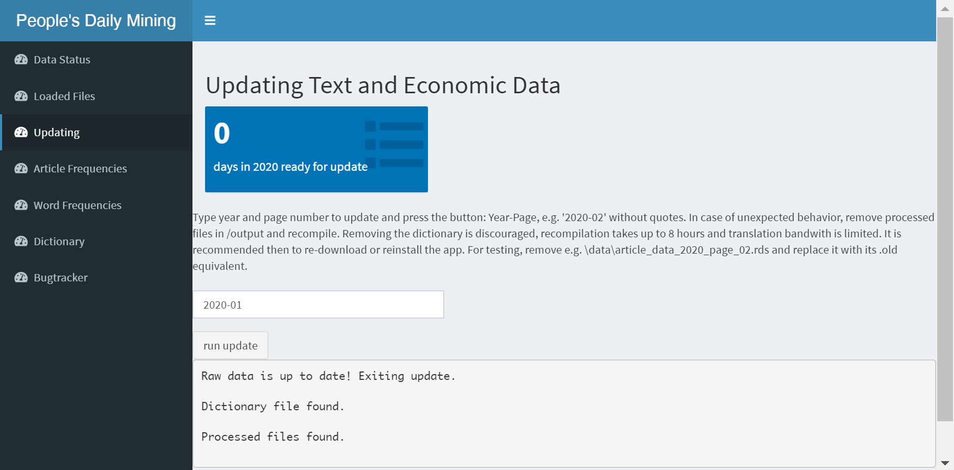
2. Shiny App, Translation
Notes:
This page will display an info on how many days have passed since the last update and will offer you the option to choose a page and year to update. This is useful if you want to regenerate 2019 data from scratch or update pages individually, since the response time of the website can cause the update to take a long time, if many dates are requested. In the box below, info on the updating process is reported, which is helpful for tracing errors. Unfortunately, as of this version, the app closes immediately after the update, so the report is not visible for long. It was quite difficult to find a way to capture this output. You can find the report also in the console of RStudio., and review the steps of the update process: Checking if an update is necessary, scraping the raw data, processing the files by separating words with spaces for text mining, creating a dictionary of unique expressions in the new articles, finding the new expressions not yet in the old dictionary, requesting a translation from the Yandex Translation API, updating the dictionary and translating all articles word for word. All output is saved for future use.

Slide 6
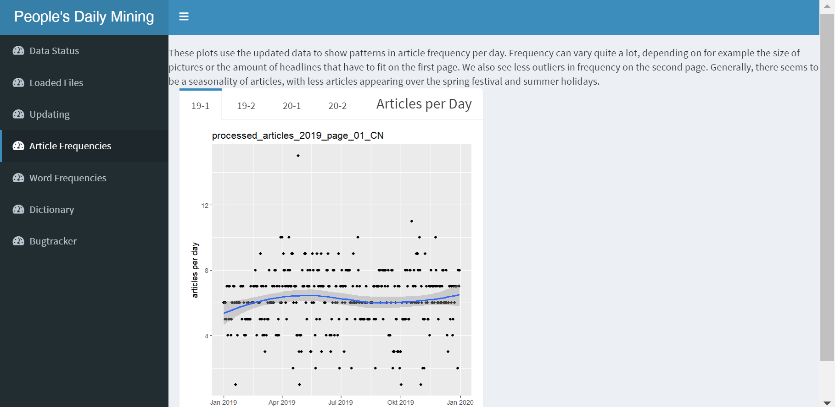
2. Shiny App, Translation
Notes:
This article frequency plot is also a good overview of the dataset. It is clear that there is great variance and a certain seasonality, with summer and winter holidays being times of fewer articles on both pages and the second page having fewer editions with a large number of articles. This variance also implies that if headlines are analysed, they could be weighted with the number of articles per day to reflect their relative prominence on the page.

Slide 7
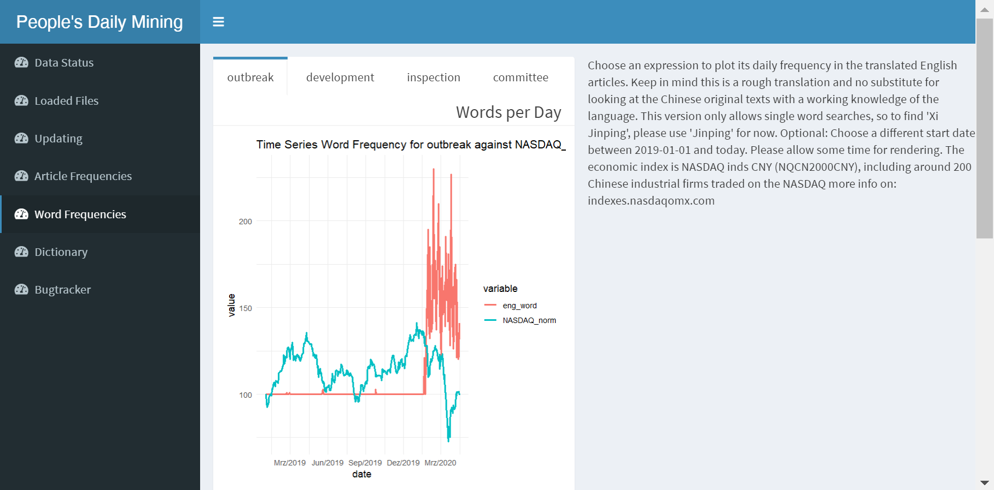
2. Shiny App, Translation
Notes:
Finally, here we come to the most prominent output of the app. This tab automatically generates three example word frequency plots, including a time series from the NASDAQ index on the total market value of several hundered listed Chinese industrial firms. The current index data is requested through the St. Louis Fed‘s FRED database API. You can choose your own expression of interest to generate a fourth plot and specify an alternative starting date, by scrolling down to reveal the two respective form entries and a „make plot“-button, but be aware that the calculation takes a around 10 seconds, because of the size of the database. Both time series are normalized to one hundred around the starting date for easier comparison. You can see in the example, that the word „outbreak“, which the People‘s Daily uses for Covid-19, spikes in January 2020, coinciding with a crash in the stock index.

Slide 8
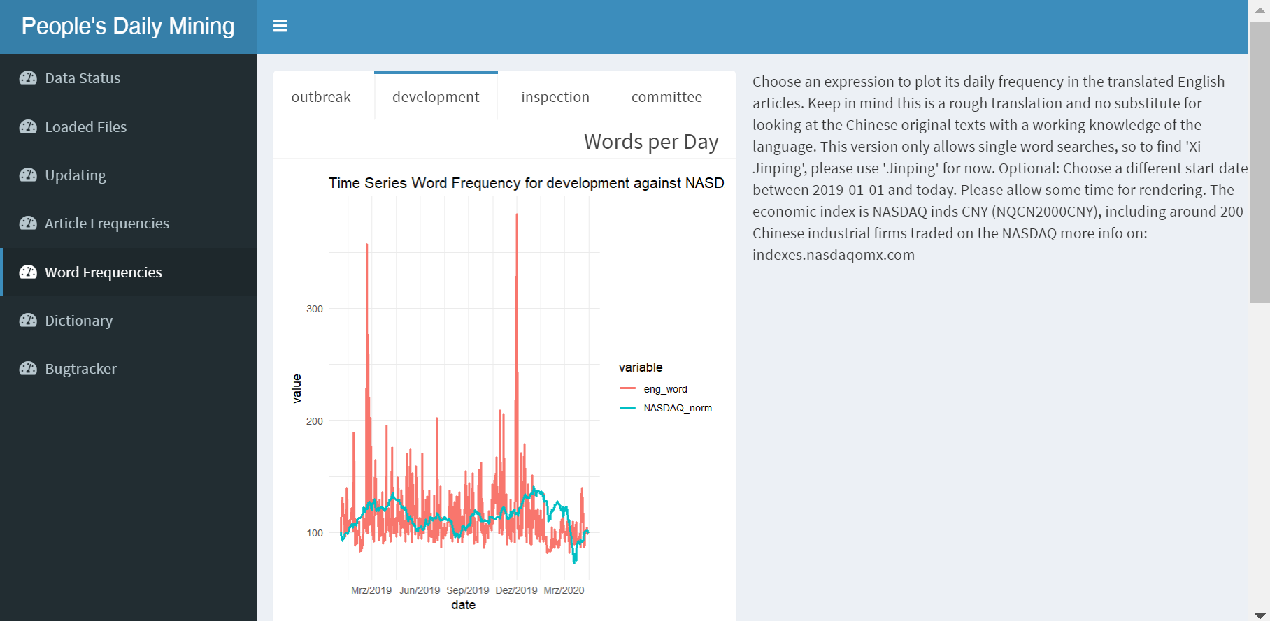
2. Shiny App, Translation
Notes:
The other plots show a decrease in economic propaganda (keyword „development“)…

Slide 9
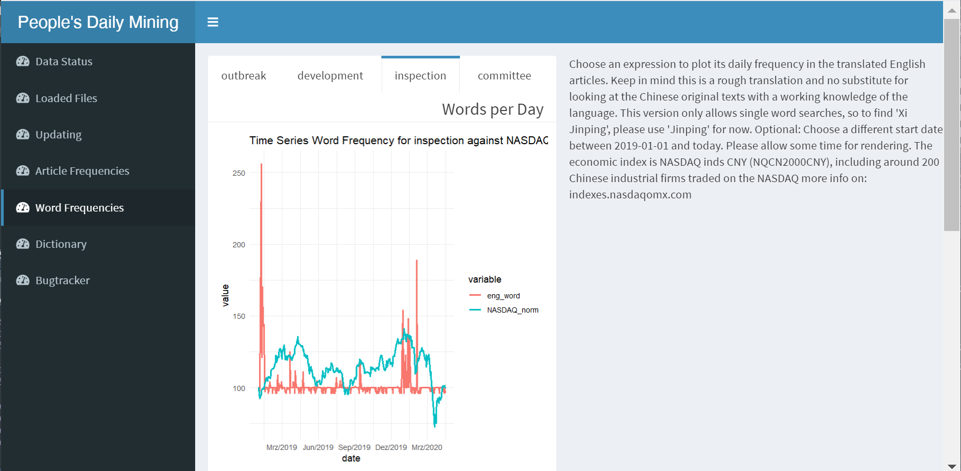
2. Shiny App, Translation
Notes:
, a spike in political activism (keyword „inspection“) …

Slide 10
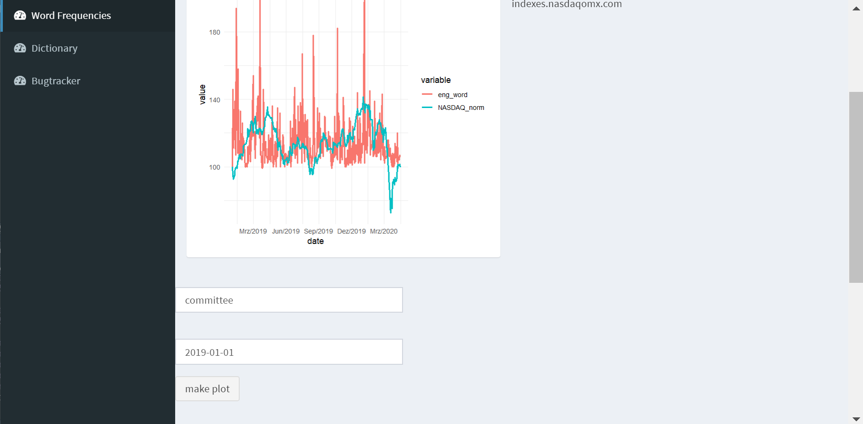
2. Shiny App, Translation
Notes:
… and a slight decrease in reporting on political topics (keyword „committee“). Here you can see the bottom of the tab, with the request form.

Slide 11
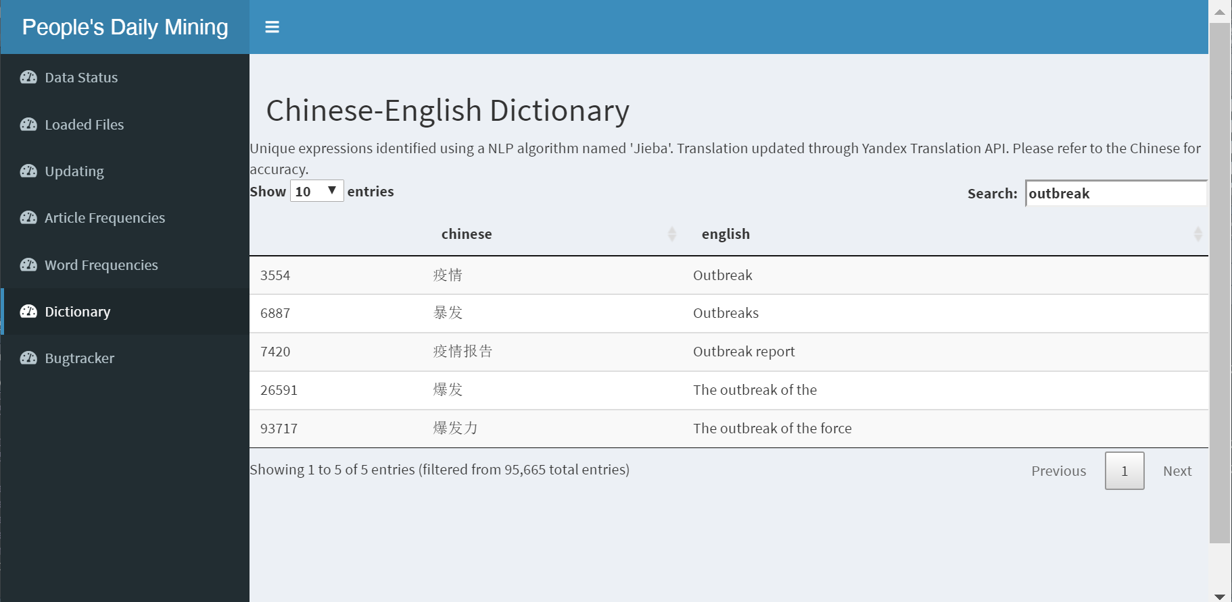
2. Shiny App, Translation
Notes:
To finish the overview of the app, here is a quick look on the searchable table in the dictionary tab. You can see that one English expression will yield multiple matching Chinese expressions, which in general is desirable, because the quality of the translation is mostly accurate and this will improve the results of text analysis. Ultimately it will be most desirable to search the original Chinese data with a knowledge of the language, which should be another feature to be implemented. I will skip the bugtracker for time reasons.

